Slide 1

Using Response Time to Study Human Behaviour
Lecture 3a: Processing RT & Error rate data

Slide 2
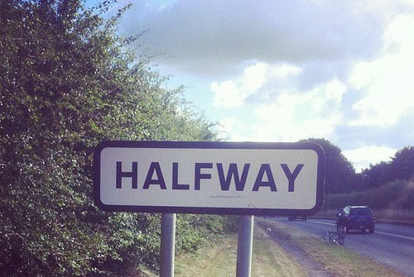
Halfway of RT block
Week 6: Designing a RT experiment
Week 7: Setting up a RT experiment
Week 8: Processing RT & Error rate data
Week 9: Processing RT & Error rate data

Slide 3
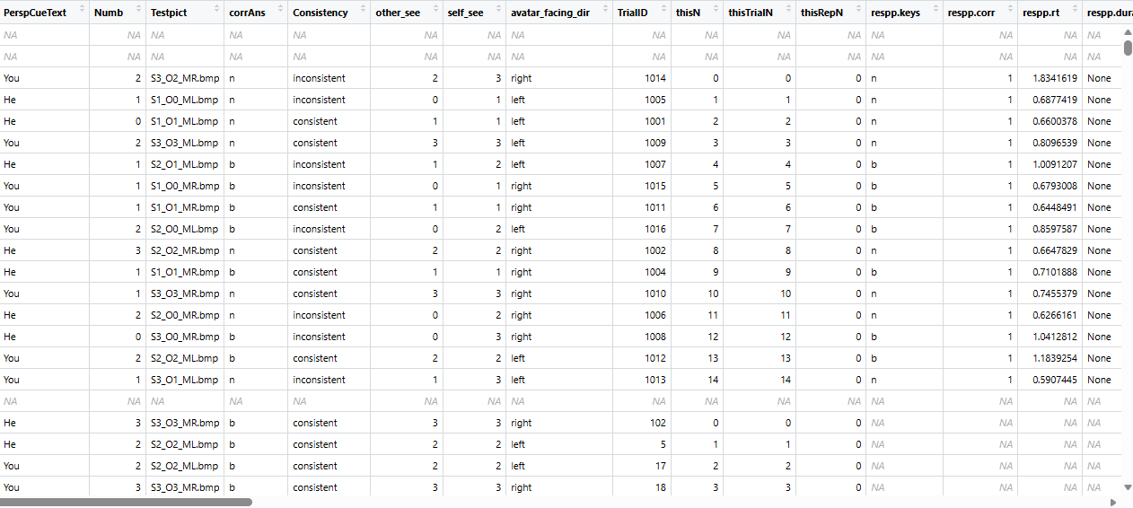
Data from the VPT task
Practice Block
Block 1
Block 2

Slide 4
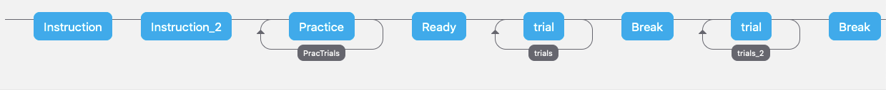
Data from the VPT task
Practice Block
Block 1
Block 2

Slide 5
Data from the VPT task
Practice Block
Block 1
Block 2
Broad data categories:
 | RT | Error rate
Practice trials | x | Check understanding
Test trials | DV1 | DV2

Slide 6
Error rate (ERR)
ERR is the percentage of trials that contains an incorrect response
ERR compliments RT
  A form of processing cost in its own right
  Help us detect speed-and-accuracy tradeoff

Slide 7
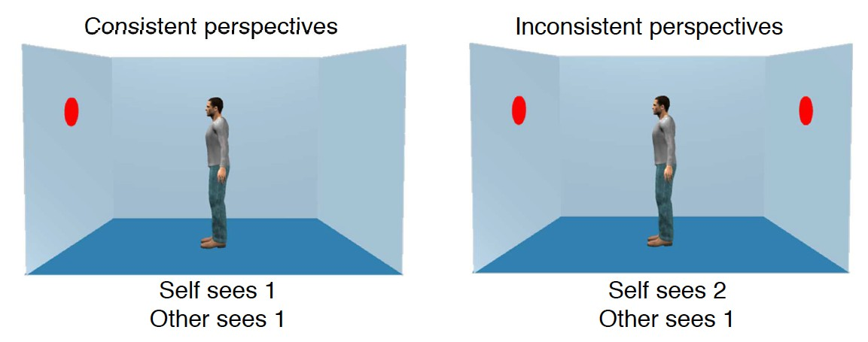
Samson et al., 2010
2 x 2 within-participant design
  Consistency (consistent, inconsistent)
  Perspective (Self, Other)

Slide 8
Samson et al., 2010
“He” trials / “Other” in the dataset
  Explicitly cued to take the avatar’s perspective
  Additional time needed in the inconsistent condition reflects interference from your own perspective

Slide 9
Samson et al., 2010
“You” trials / “self” in dataset
  Explicitly cued to take the one’s own perspective
    Opportunity for implicit processing of the avatar’s perspective
  Additional time needed in the inconsistent condition reflects interference from the avatar’s perspective
  Evidence for automatic perspective-taking?
    Control experiment with a stick instead of an avatar

Slide 10
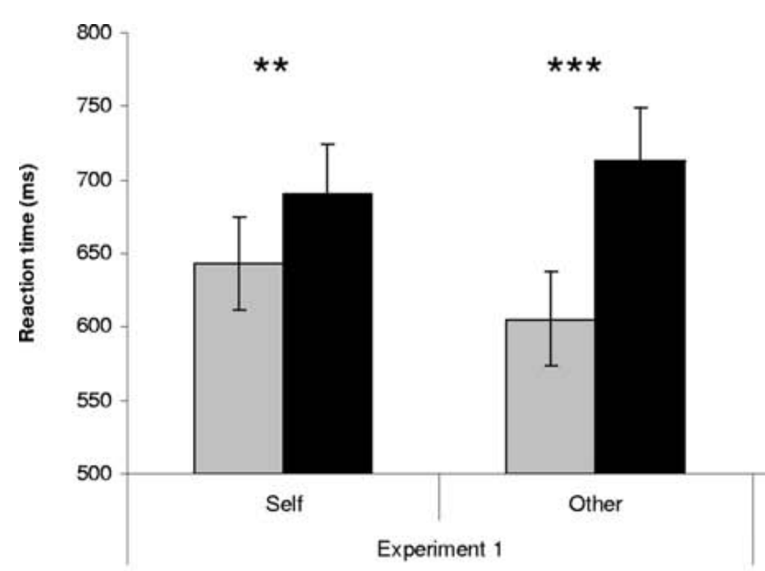
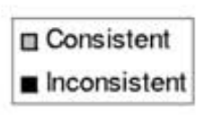
Samson et al., 2010
Egocentric effect
  Other-inconsistent > other- consistent
  Spontaneous processing of your own perspective
Altercentric effect
  Self-inconsistent > self- consistent
  Spontaneous processing of the avatar’s perspective

Slide 11
Samson et al., 2010
Egocentric effect
  Other-inconsistent > other- consistent
  Spontaneous processing of your own perspective
Altercentric effect
  Self-inconsistent > self- consistent
  Spontaneous processing of the avatar’s perspective

Slide 12
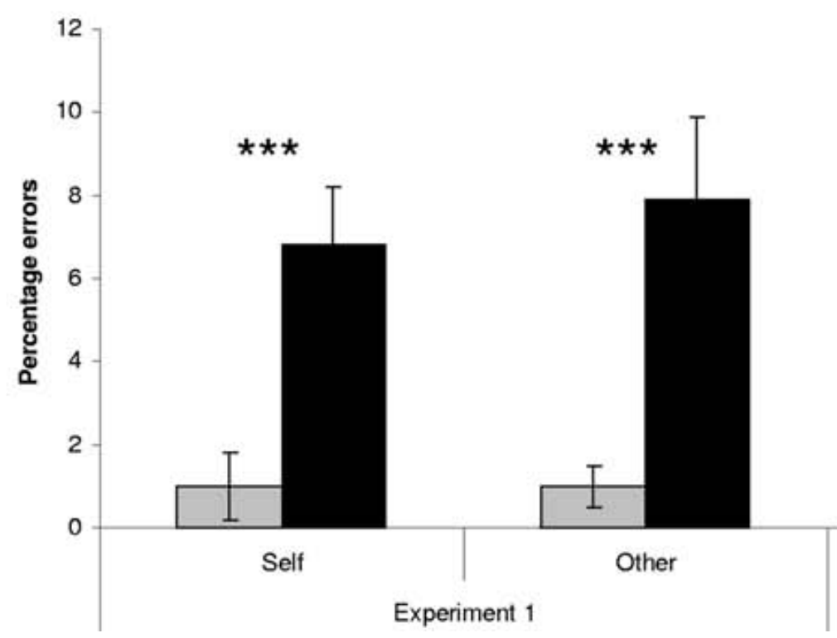
Error rate (ERR)
ERR is the percentage of trials that contains an incorrect response
ERR compliments RT
  A form of processing cost in its own right
  Help us detect speed-and-accuracy tradeoff

Slide 13
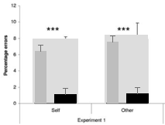
Error rate (ERR)
ERR is the percentage of trials that contains an incorrect response
ERR compliments RT
  A form of processing cost in its own right
  Help us detect speed-and-accuracy tradeoff

Slide 14
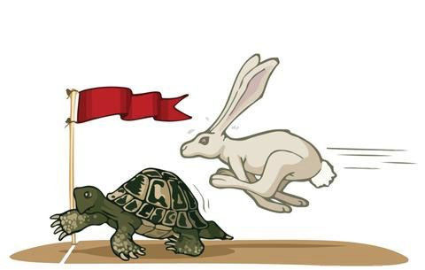

Speed and accuracy tradeoff (SAT)
When high accuracy rates are associated with slow trials; low accuracy rates associated with fast trials
Fast vs. slow RTs reflect difference in response strategy rather than processing cost
– Important to know if your RT pattern reflects true difference in processing cost

Slide 15
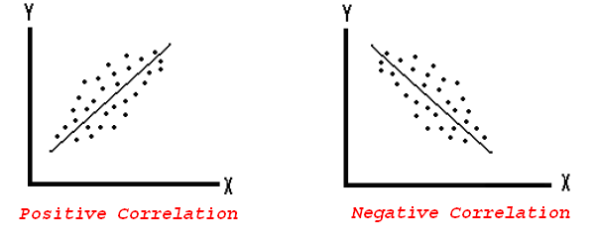
Speed and accuracy tradeoff (SAT)
Use correlational analysis to detect SAT
Which of the plots show a SAT?
Accuracy
Accuracy
RT
RT
SAT: slow RT associated with more accurate performance

Slide 16
Data from the VPT task
Practice Block
Block 1
Block 2
Broad data categories:
 | RT | Error rate
Practice trials | x | Check understanding
Test trials | DV1 | DV2

Slide 17
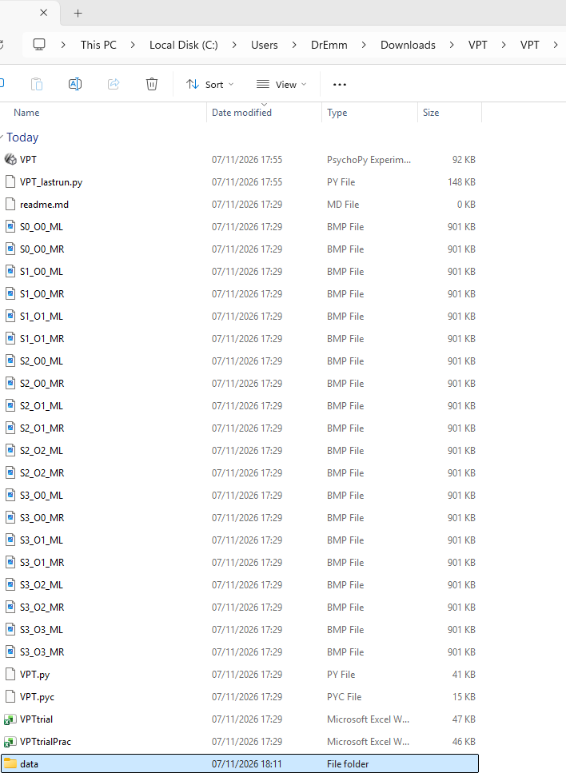
Finding your data files
In the folder where your
.psyexp file is stored, you will find a ‘data’ folder

Slide 18
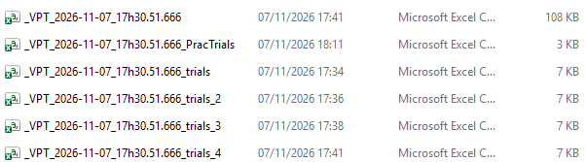
Finding your data files
Here a .csv file for each block and a “master” .csv file is created (look at the names and sizes of each file here)

Slide 19
Finding your data files
The file name is the task_date_time_Participant number

Slide 20
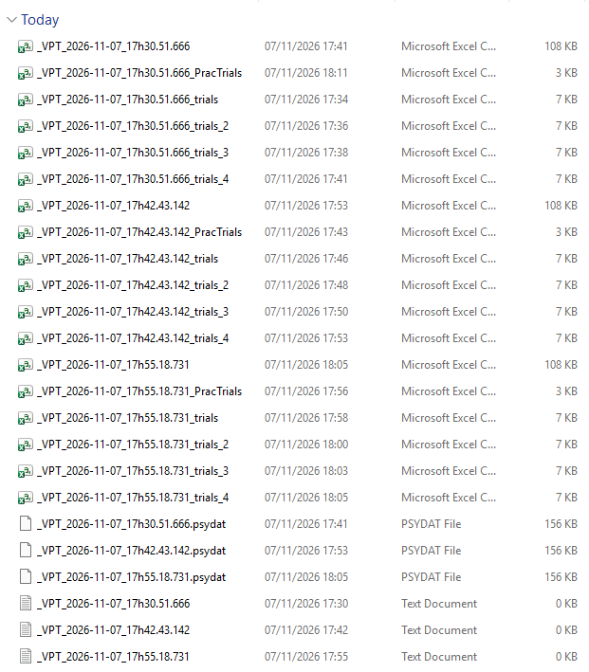
Finding your data files
Participants completing the same experiment on the same machine will be stored in the data folder:

Slide 21
Finding your data files
Three participants’ data here

Slide 22
Finding your data files
Three participants’ data here

Slide 23
Finding your data files
Three participants’ data here

Slide 24
Finding your data files
Three participants’ data here

Slide 25
Finding your data files
These are not .csv files and are not involved in your analysis

Slide 26
Finding your data files
Of the many .csv files, it is the big .csv file for each participant that you want to upload to R

Slide 27
Storing a Master File of Your Data
Recommended practice
    Copy data file to OneDrive and rename it data_master
    Copy that file and rename it data_raw
    Remove the smaller trials.csv files from data_raw so that you just have the larger .csv file for each participant in data_raw
    Compress that file
    Download to your computer ready for upload to R.

Slide 28

How do you know if your data are ALL there?
We can:
Move .csv. files to one folder and zip
Upload to R
Import multiple files at once and combine
Make a Participant ID variable
Filter out practice trials
Count the number of observations per participant / condition
Reduce the number of columns to only those that are useful
Transform our RT data from seconds to milliseconds
Generate mean RT and Accuracy rate per participant per condition and use these to check for a speed-accuracy tradeoff (SAT)

Slide 29
Reading your data
Check that all key information is recorded correctly
  Participant number: R will make them for us if not there
  Conditions
    2 factors in a 2x2 design (consistency, perspective)
    We will get these from PerspCueText and Consistency

Slide 30
Data from the VPT task after some preparation in R

Slide 31
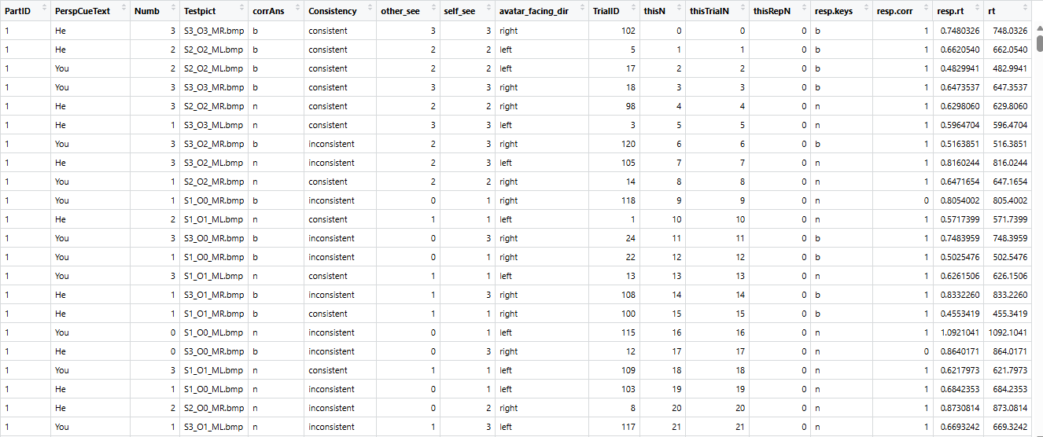
Data from the VPT task after some preparation in R

Slide 32
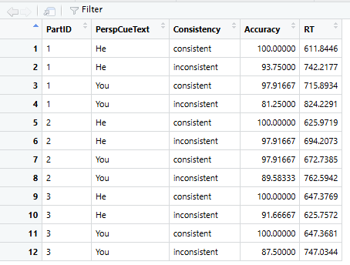
Data from the VPT task after some preparation in R

Slide 33
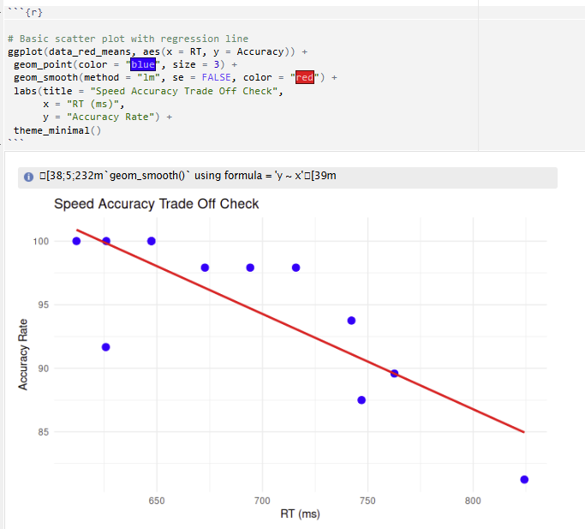
Data from the VPT task after some preparation in R

Slide 34

Take a break & ask yourself
Have you understood what speed and accuracy tradeoff (SAT) is?

Slide 35
Lecture 3b: RT data processing: Participant-level exclusion criteria
Using Response Time to Study Human Behaviour

Slide 36
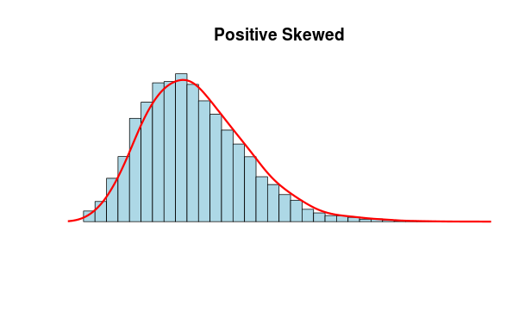


Factors that can influence signal-to-noise ratio in RT
Signal-to-noise (S/N) ratio
S/N ratio needs to be as large as possible
‘Clean data’ is key to interpretability of results

Slide 37
Pros and cons to using RT as a DV
Pros
Cons
A sensitive measure
Able to detect effects that may not be apparent in explicit responses e.g., response accuracy, questionnaire
Lesser influence from the experimenter (but correct instructions and design are important!)
The data is highly variable
Data is usually skewed and require additional processing before analysis

Slide 38

Prepare your data
Before chopping a carrot, you need to…
Wash the carrot
Peel off the skin
Chop off the top
Before analysing RT data, you need to…
Think about which participants you could include

Slide 39
Prepare your data
Before chopping a carrot, you need to…
Wash the carrot
Peel off the skin
Chop off the top
Before analysing RT data, you need to…
Think about which participants you could include
  Attention checks for online testing
  Check against chance level for both in-person and online testing

Slide 40


Can you use the data from a participant who responded at chance?
Chance
  Responses generated without properly processing the stimuli = noise!
  In a balanced yes/no response task, a person who presses one response key throughout the task will achieve 50% accuracy

Slide 41
Chance-level performance
What is the minimum number of heads that would need to occur in 50 coin tosses for us to conclude that the coin has a statistically significant bias for heads?
  26
  30
  32
  38

Slide 42
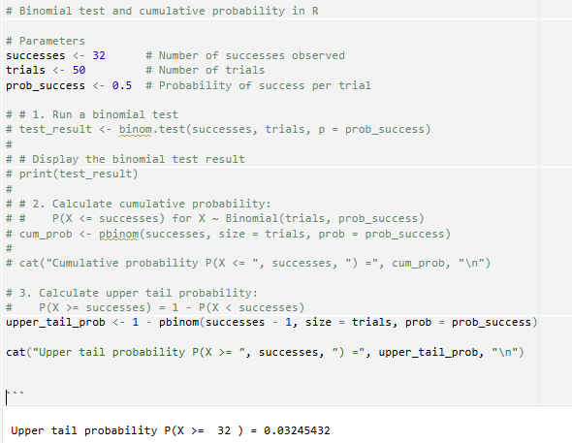
Binomial Test
A yes/no response task has a binary outcome (probability of 0.5 for each outcome), much like a coin toss
We can use a binomial test to determine fairness of a coin
In our coin toss example, we want to know the probability that the coin is unbiased given 32 head out of 50 tosses…a sequence of trials rather than a single trial…

Slide 43
Binomial Test
A yes/no response task has a binary outcome (probability of 0.5 for each outcome), much like a coin toss
In our coin toss example, we want to know the probability that the coin is unbiased given 32 head out of 50 tosses…a sequence of trials rather than a single trial…
Critically – we ask for the cumulative probability of the upper tail of the distribution

Slide 44
Take a break & ask yourself
Can you report trials associated with ‘Yes’ and ‘No’ (or consistent and inconsistent) responses together?
Can you include erroneous trials in an analysis?
Can you include RT from erroneous trials in a RT report?

Slide 45
Using Response Time to Study Human Behaviour
Lecture 3c: RT data processing: Trial-level exclusion criteria

Slide 46
Prepare your data
Before chopping a carrot, you need to…
Wash the carrot
Peel off the skin
Chop off the top
Before analysing RT data, you need to…
Think about which participants you could include
Think about which data points you could include

Slide 47

Can you report trials associated with ‘Yes’ and ‘No’ responses together?
Yes, they are both speeded responses
No, you need to report them separately
No responses cannot be reported
Yes
No
Index finger on ‘B’
Middle finger on ‘N’

Slide 48
Can you report trials associated with ‘Yes’ and ‘No’ responses together in an RT analysis?
Yes, they are both speeded responses
No, you need to report them separately
No responses cannot be reported
Yes
No
Index finger on ‘B’
Middle finger on ‘N’

Slide 49
Can you describe erroneous trials?
Yes, as error rates
In an RT analysis, reporting error rates in the descriptive statistics is important to show that you have no speed accuracy tradeoff effect.
The high error rates for the black bars here align with the larger values for the more difficult trials on the RT bars in the chart on the left.

Slide 50
Can you include RT from erroneous trials in an RT analysis?
Yes No

Slide 51
Prepare your data
Before chopping a carrot, you need to…
Wash the carrot
Peel off the skin
Chop off the top
Before analysing RT data, you need to…
Think about which participants you could include
Think about which data points you could include
  Responses to consistent trials
  Correctly responded trials
  Responses that are not impossibly fast

Slide 52






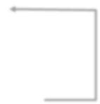


Trial-level data processing
Data from test trials
"Yes" response
"No"
response
correct
incorrect
Distribution of RT data
Normal (skewness, kurtosis)
Not normal
Parametric analysis
Trim extreme values
Transform data

Slide 53

Trial-level data processing
Data from test trials
Separate Yes/No responses For the VPT task, only ‘yes’
"Yes" response
"No"
response
response are analysed
correct
incorrect
Distribution of RT data
Normal (skewness, kurtosis)
Not normal
Parametric analysis
Trim extreme values
Transform data

Slide 54

Trial-level data processing
Data from test trials
"Yes" response
"No"
response
ERR analysis
correct
incorrect
Distribution of RT data
Normal (skewness, kurtosis)
Not normal
Parametric analysis
Trim extreme values
Transform data

Slide 55

Trial-level data processing
Data from test trials
"Yes" response
"No"
response
RT analysis
correct
incorrect
Distribution of RT data
Normal (skewness, kurtosis)
Not normal
Parametric analysis
Trim extreme values
Transform data

Slide 56

What about super fast responses?
Responses under 150ms is unlikely to be genuine responses
  Jumping the gun
  Residual effect from the previous trial
  Involuntary motor response
We will consider slow RT data next week
  Slow RT often skews the dataset

Slide 57

Trial-level data processing
Data from test trials
"Yes" response
"No"
response
correct
incorrect
Distribution of RT data
Normal (skewness, kurtosis)
Not normal
Next lecture
Parametric analysis
Trim extreme values
Transform data

Slide 58
Take a break & ask yourself
How will you identify the following trials in a data spreadsheet?
  Responses to Yes trials
  Correctly responded trials
  Responses that are slower than 150ms
  The lab activity will take you through preparing data in the way that has been described

Slide 59
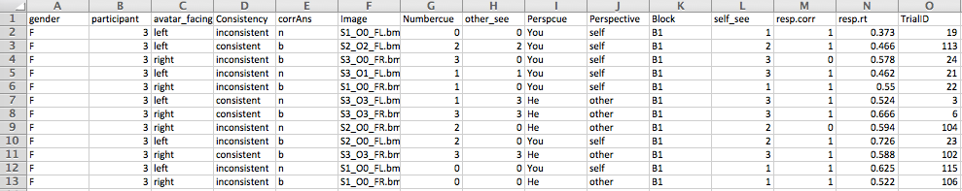
Wang et al. (2019) dataset
From a cross-cultural study (Wang et al., 2019)
30 British participants did the VPT task and a referential communication task
Matched in age, gender, year and subject of study to 30 Taiwanese participants

